Slide 1
CAR MANUFACTURING APP

Slide 2
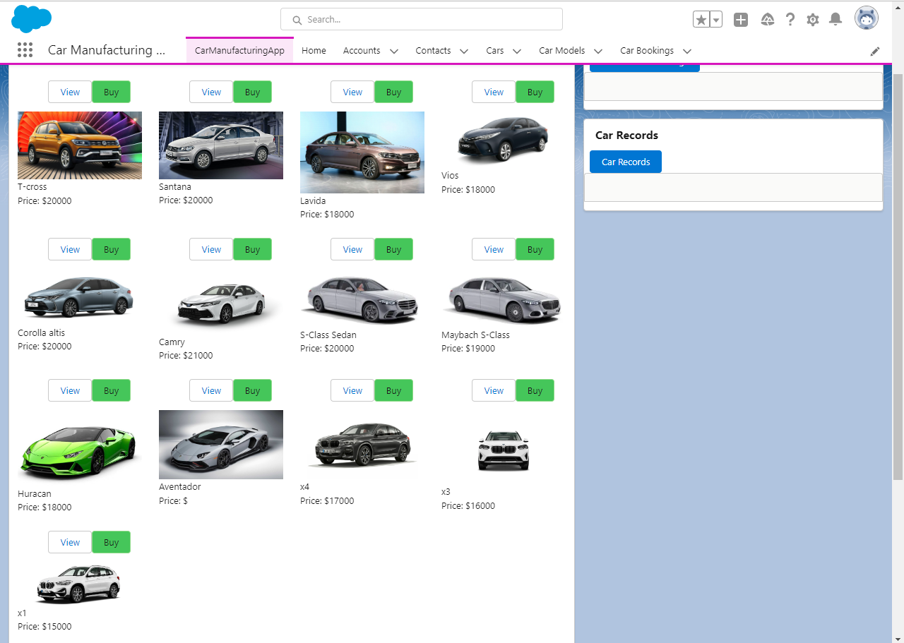
View as customer

Slide 3
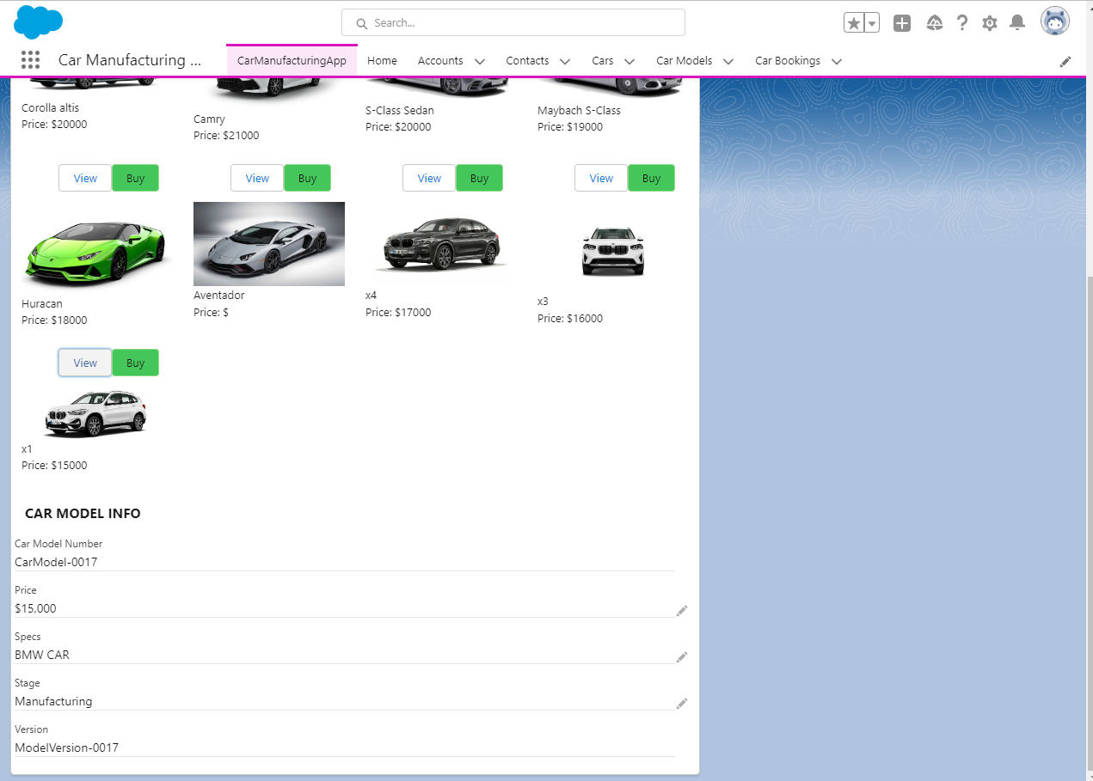
Customer view a car

Slide 4
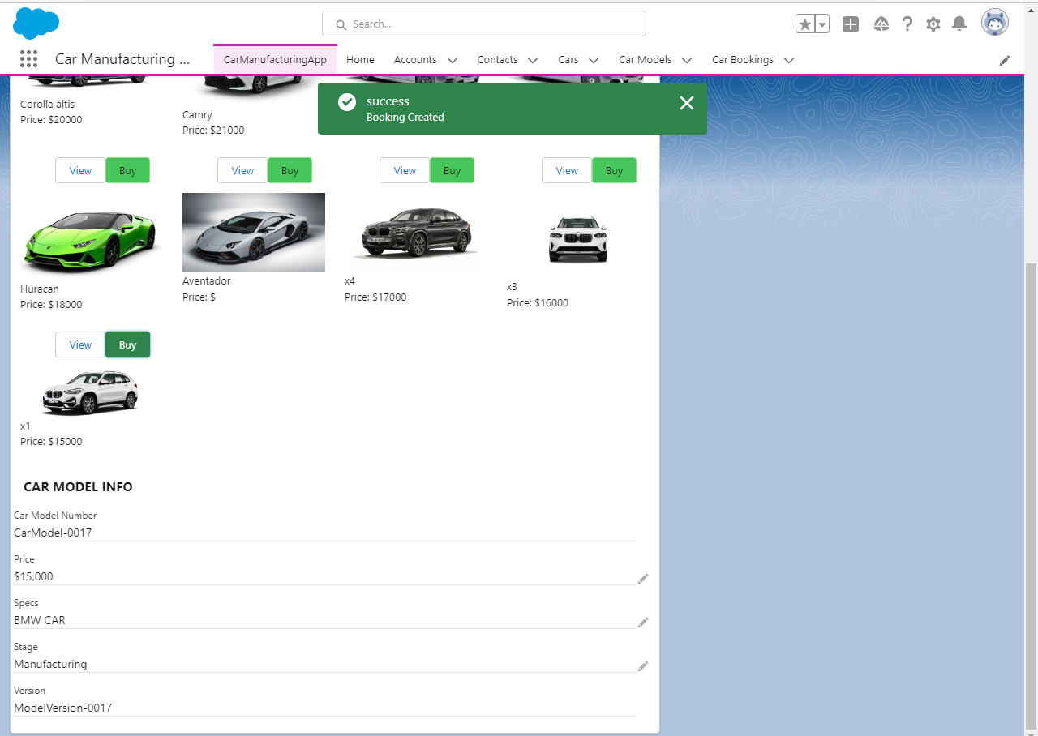
Customer buy a car

Slide 5
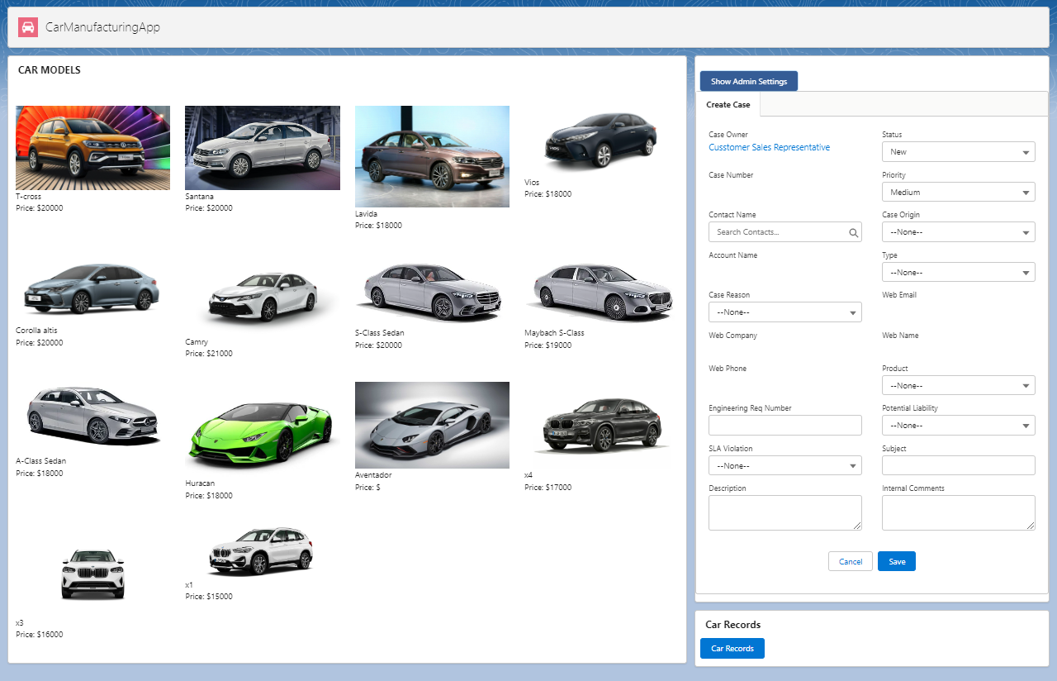
VIEW AS CUSTOMER SALES REPRESENTATIVE

Slide 6
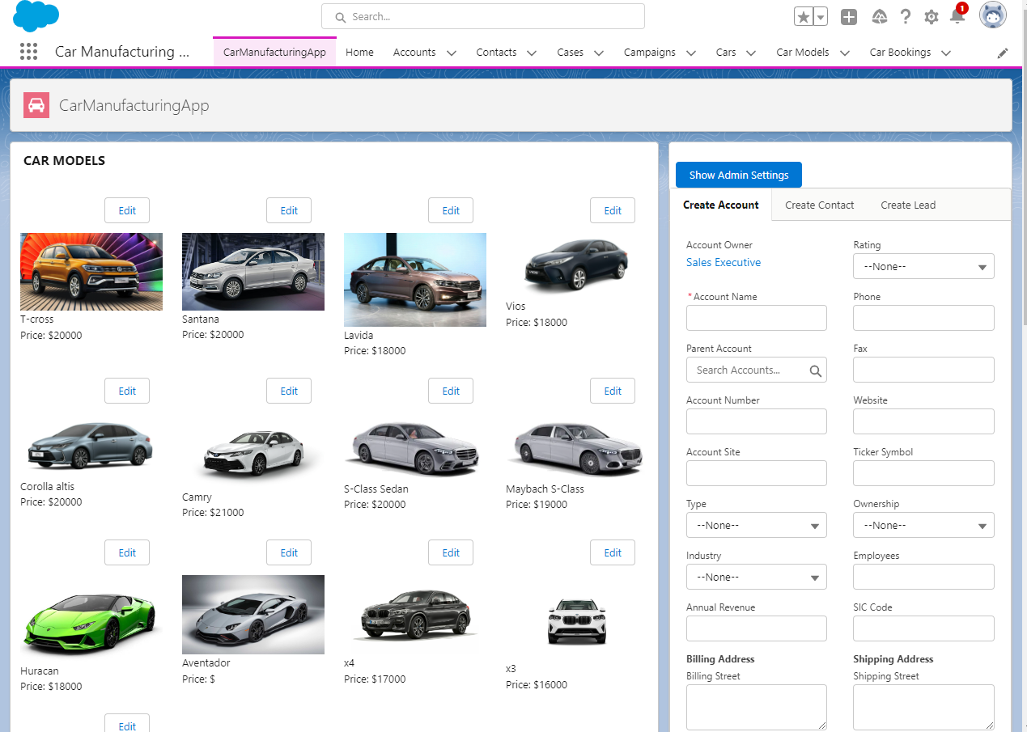
VIEW AS Sales EXECUTIVE

Slide 7
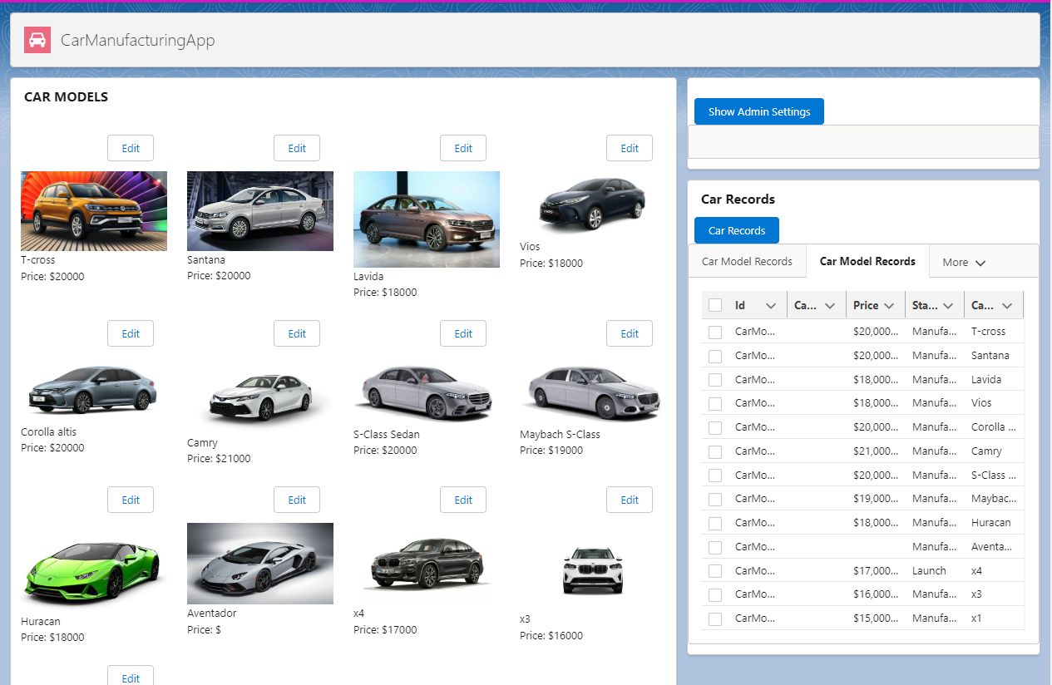
VIEW AS Sales EXECUTIVE

Slide 8
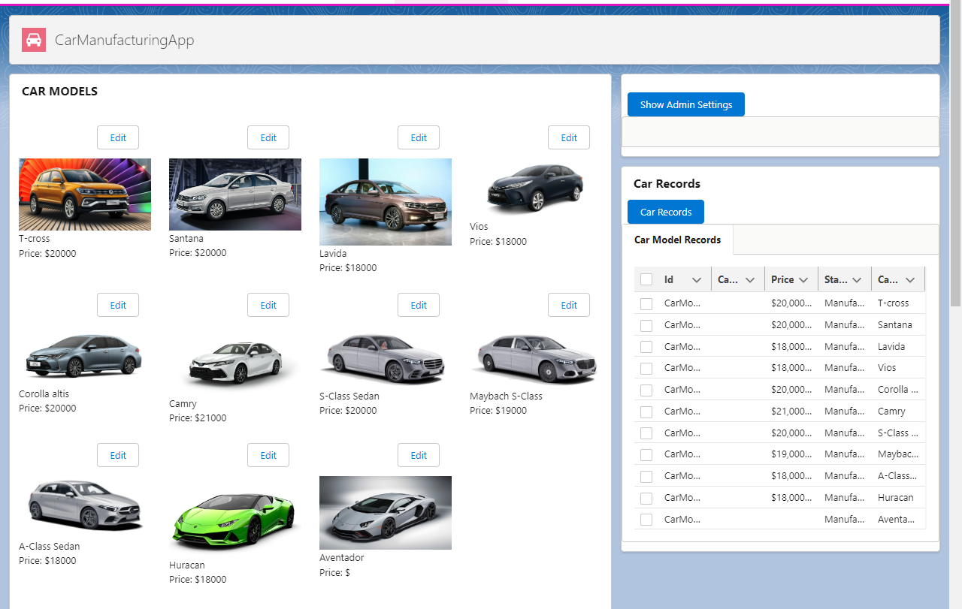
VIEW AS QUALITY ANALYST

Slide 9
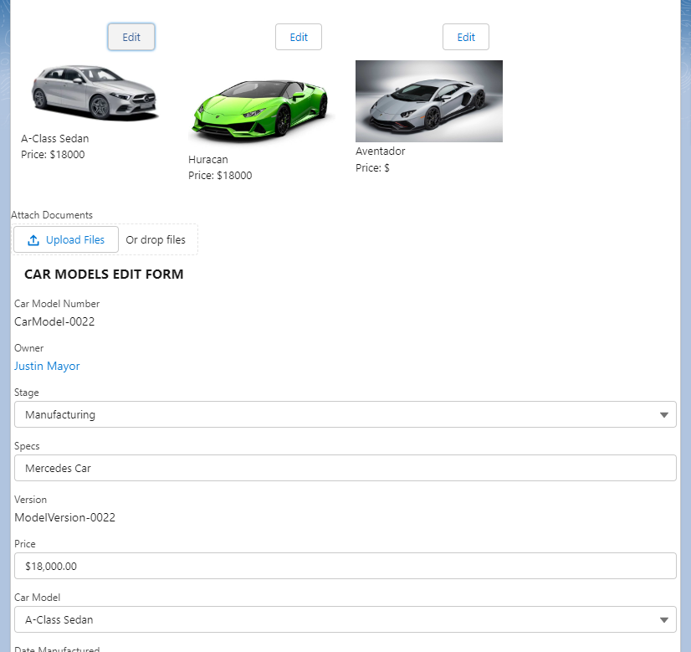
VIEW AS QUALITY ANALYST

Slide 10
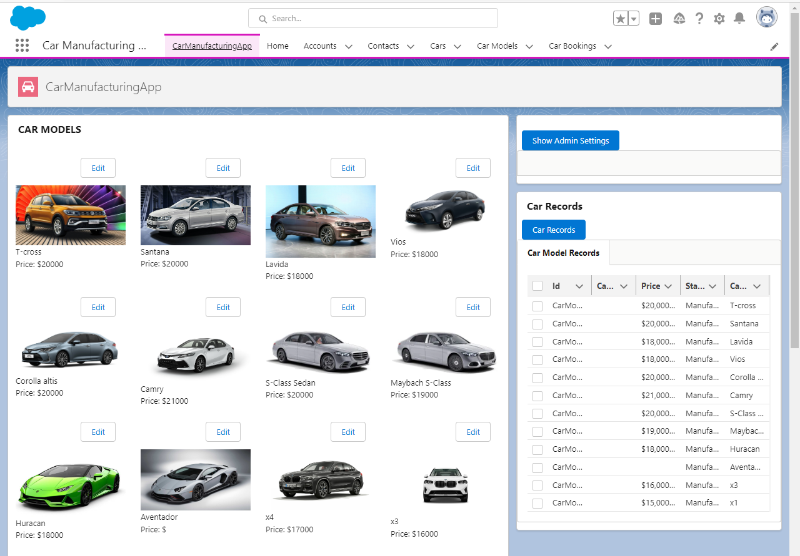
VIEW AS FACTORY EXECUTIVE

Slide 11
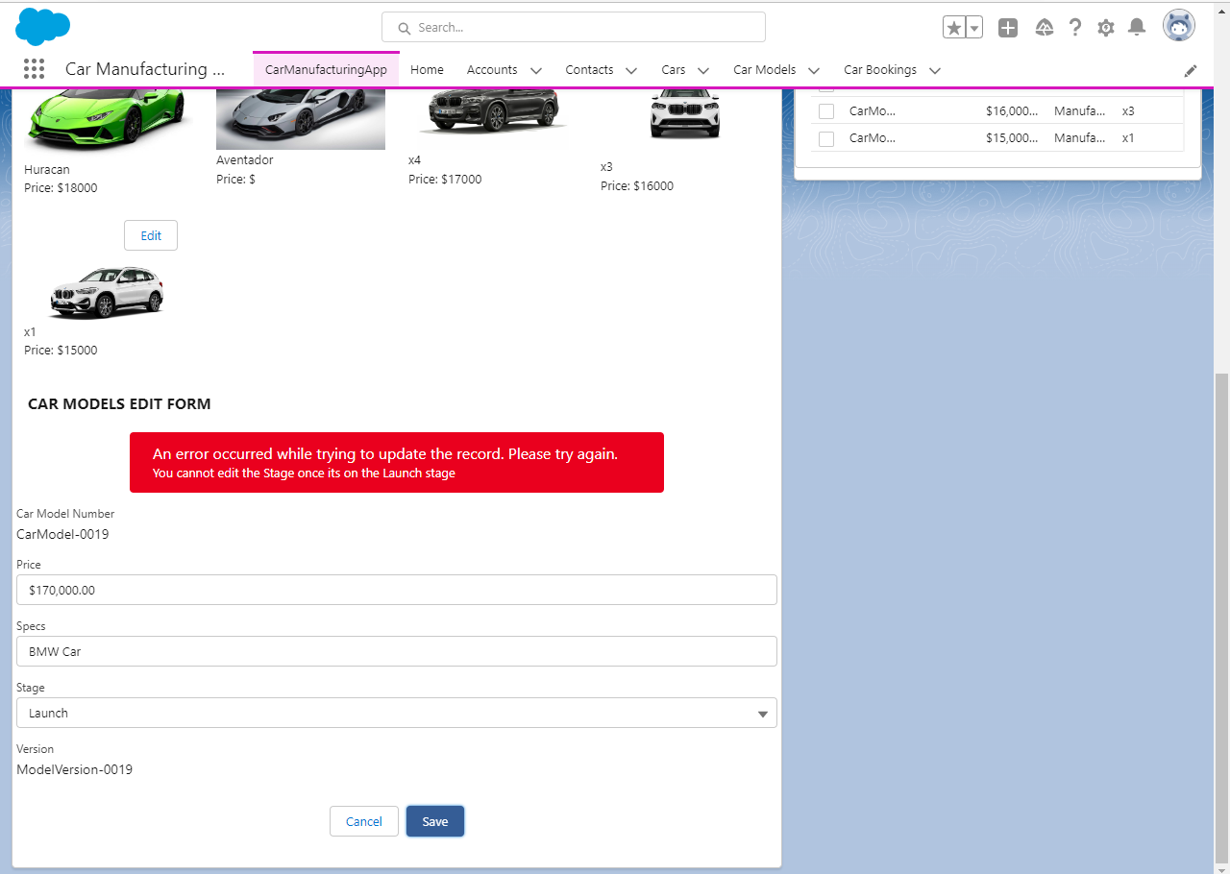
VIEW AS FACTORY EXECUTIVE when try to edit a carmodel which is on launch

Slide 12
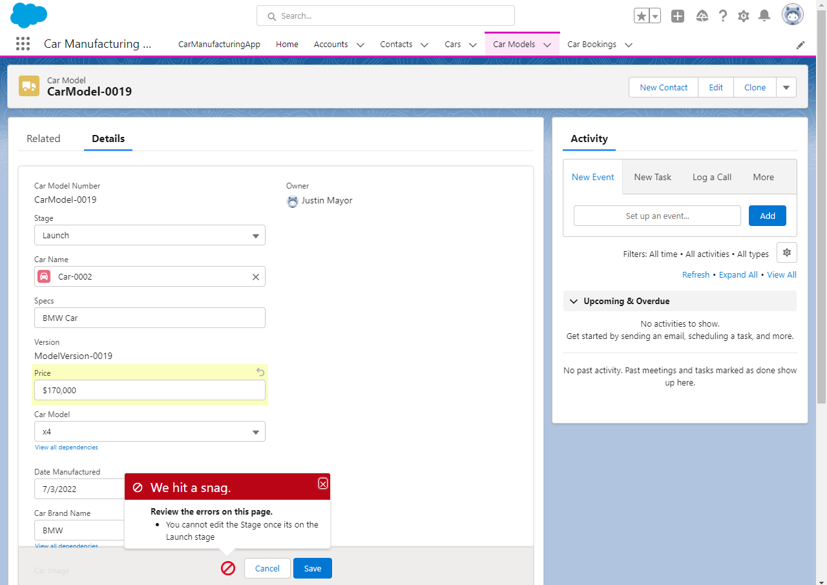
VIEW AS FACTORY EXECUTIVE when try to edit a carmodel which is on launch

Slide 13
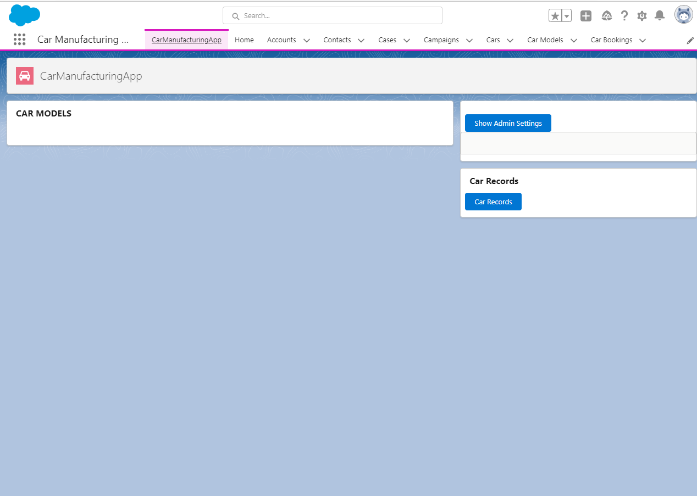
VIEW AS DIGITAL MARKETERS when car is still in manufacturing stage

Slide 14
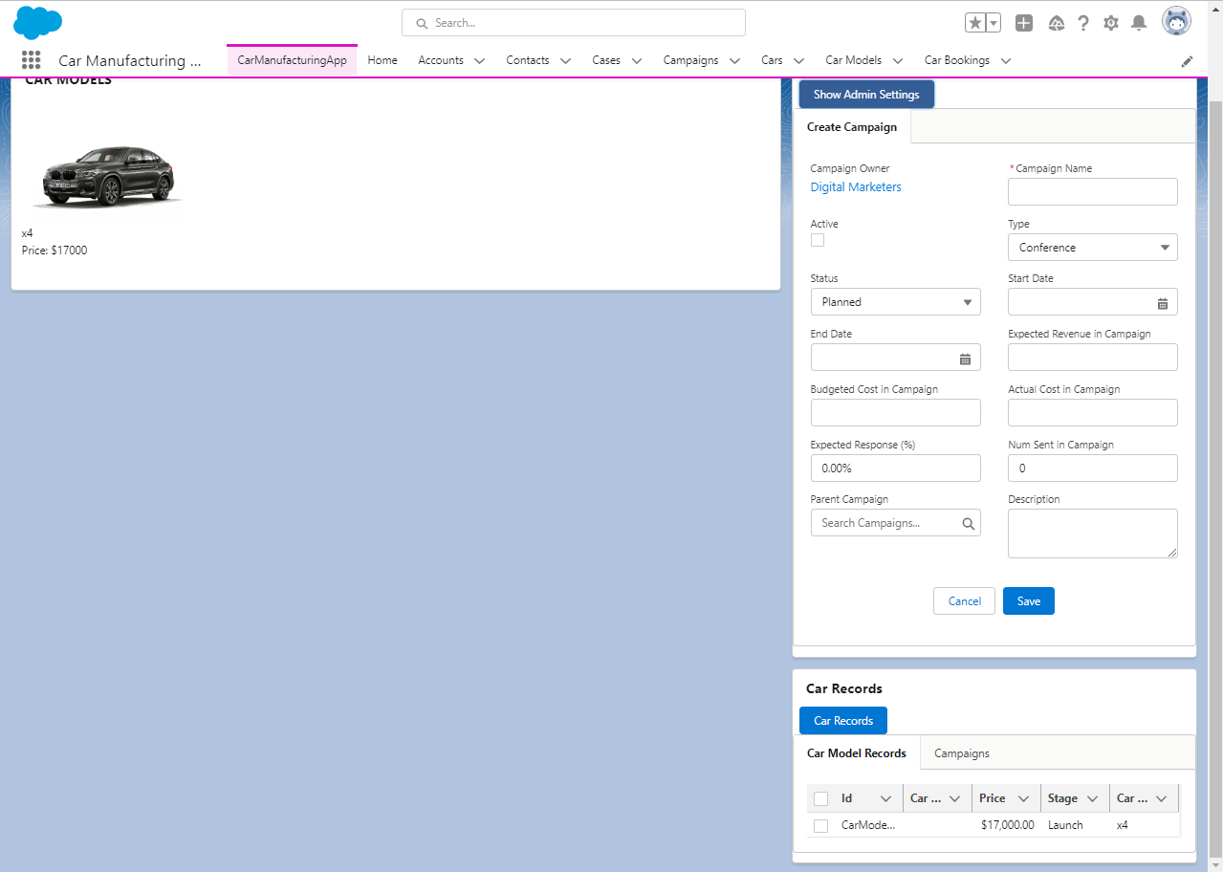
VIEW AS DIGITAL MARKETERS when car is still in manufacturing stage

Slide 15
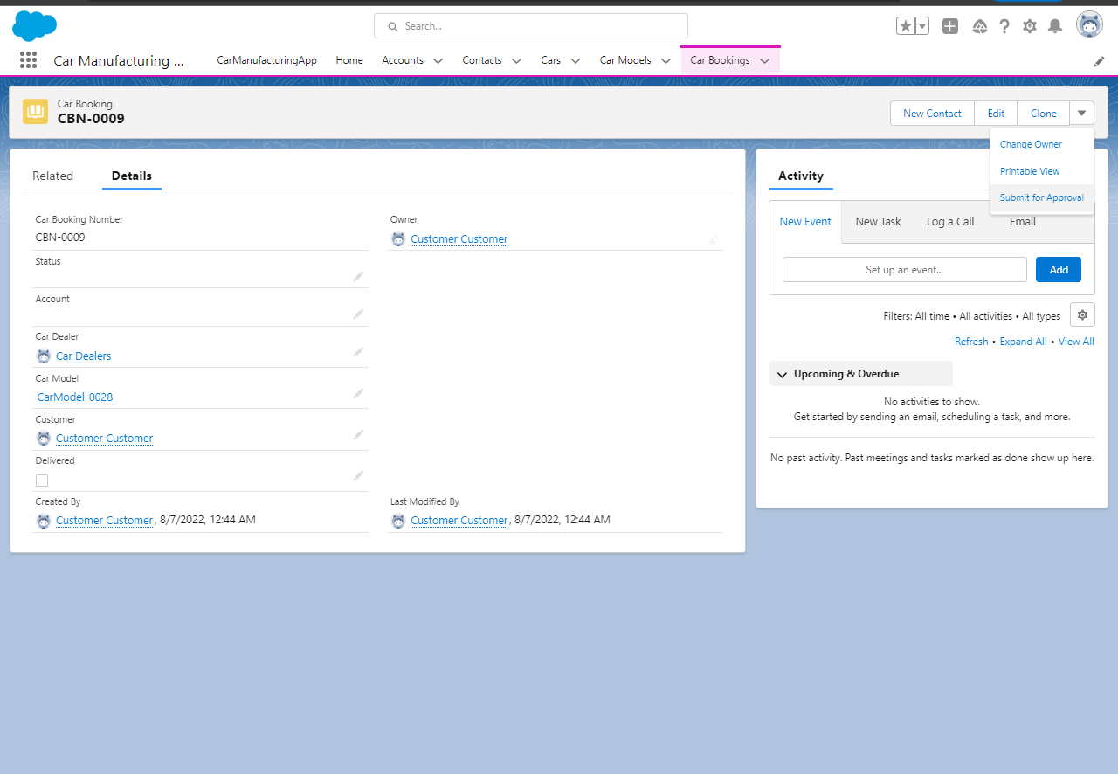
VIEW AS CUSTOMER WHEN BUYING

Slide 16
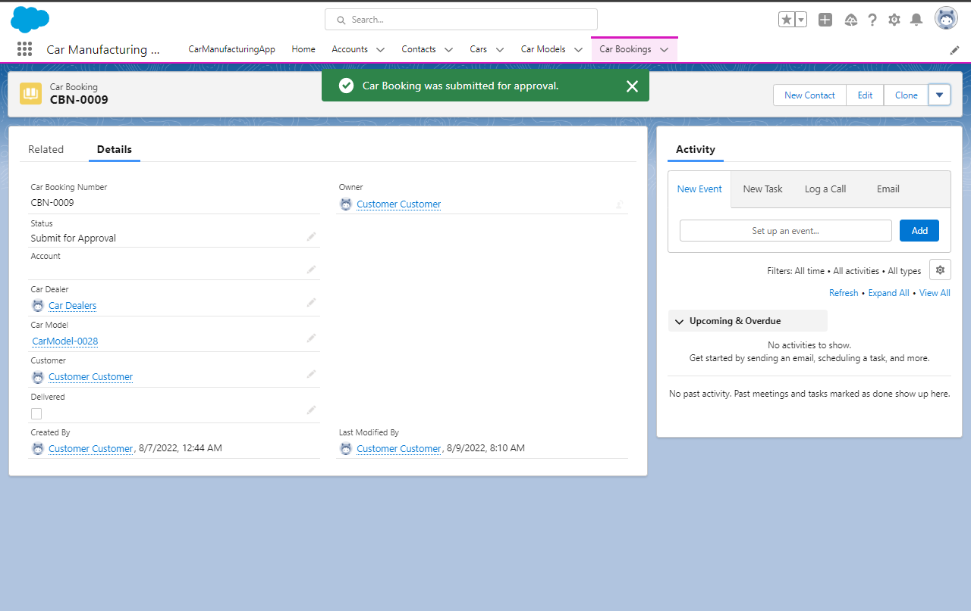
VIEW AS CUSTOMER WHEN BUYING

Slide 17
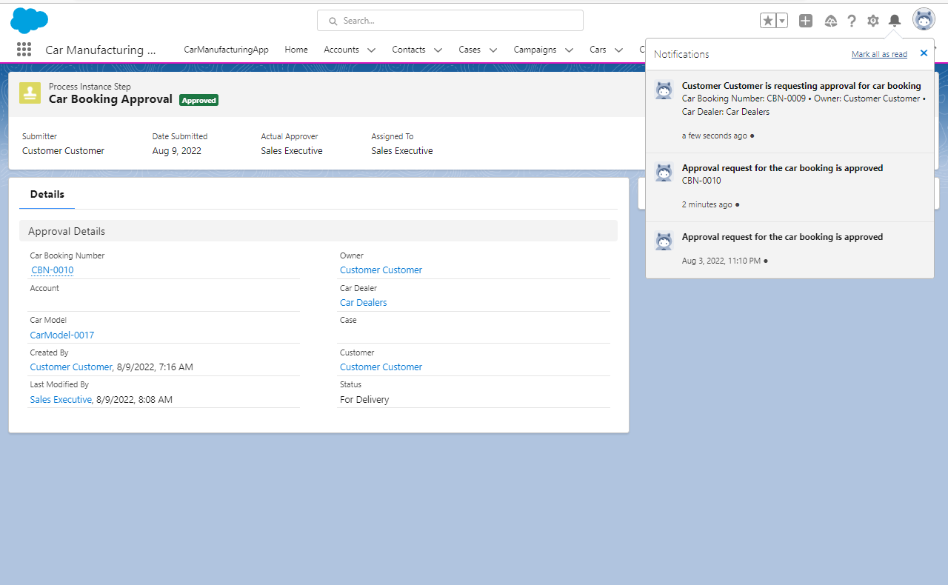
VIEW AS SALES EXECUTIVE WHEN CUSTOMER SENT REQUEST

Slide 18
VIEW AS SALES EXECUTIVE WHEN CUSTOMER SENT REQUEST

Slide 19
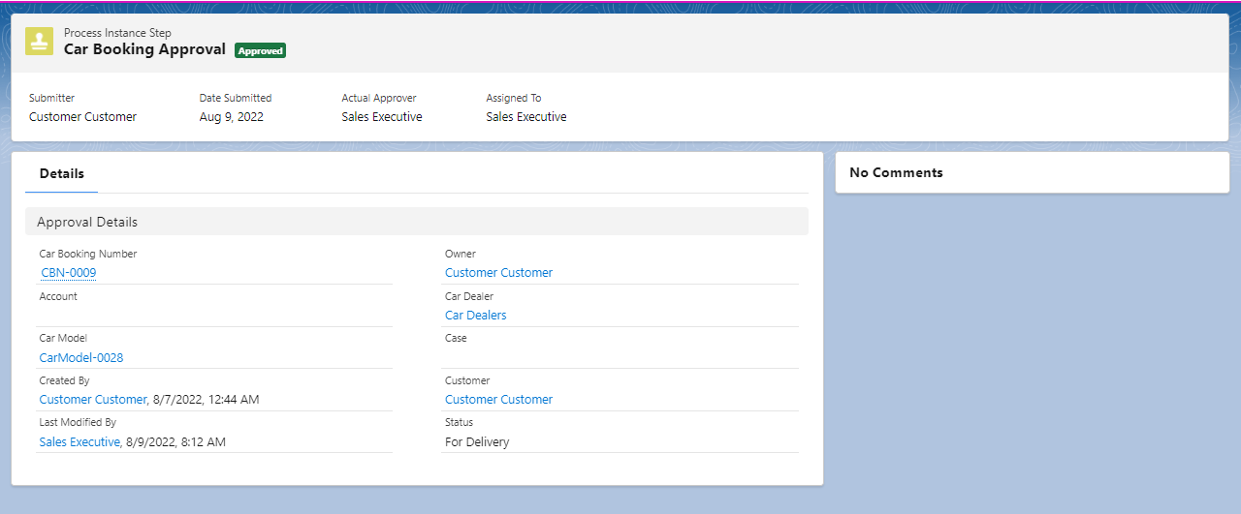
VIEW AS SALES EXECUTIVE WHEN CUSTOMER’s REQUEST was approved

Slide 20
VIEW AS SALES EXECUTIVE WHEN CUSTOMER’s REQUEST was approved

Slide 21
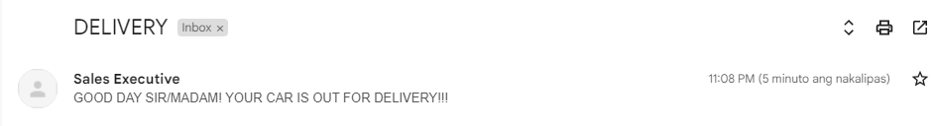
EMAIL SENT WHEN APPROVED

Slide 22
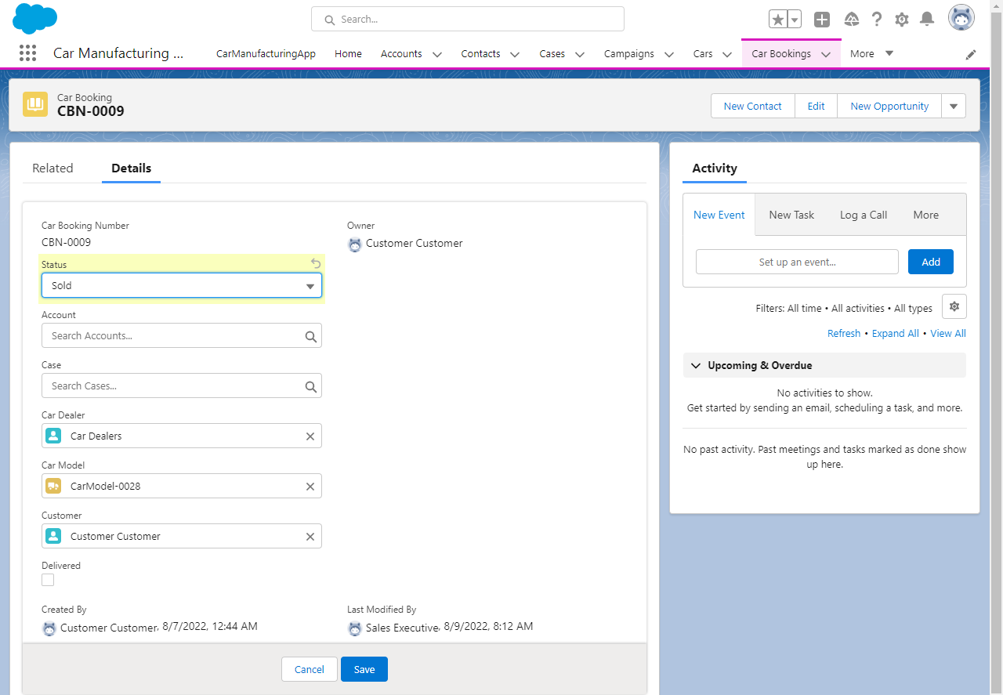
VIEW WHEN SYS AD or COMPANY EXE UPDATE THE STATUS TO SOLD

Slide 23
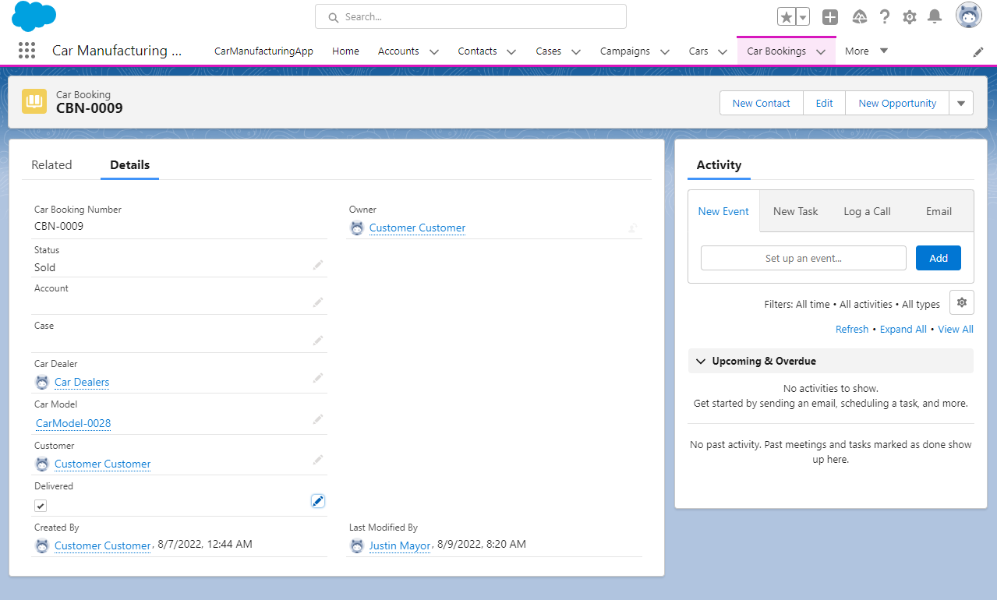
VIEW WHEN SYS AD or COMPANY EXE UPDATE THE STATUS TO SOLD

Slide 24
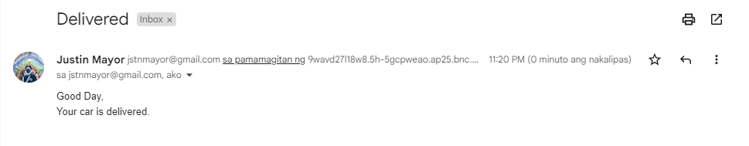
EMAIL SENT WHEN THE CAR IS DELIVERED

